Slide 1

Working on remote computers
by Pedro Henriques
June 1, 2012
Free Powerpoint Templates

Slide 2

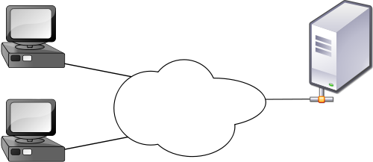

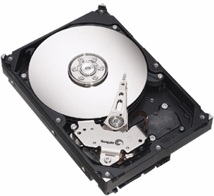
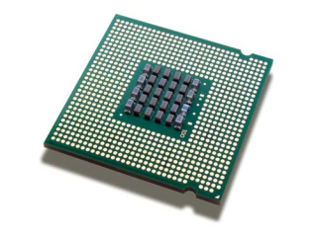
Connecting to a remote computer
Clients
Servers
Internet
Notes:
Two of the most common words you’ll hear when talking about network connections are the words CLIENT and SERVER.
The clients are you, or anybody on a computer where the connection is initiated, and the server is the remote computer that accepts this connection and provides a service! These two are connected through the internet and by this, these two are able to exchange information.
There is of course many kinds of servers. Your own laptop can be configured as a server if you want to, and of course there are servers that are made for huge data processing and storage, as for example a service provider like Google.
A server can also provide many diferent things like processing power, memory, databases and web pages, and each serviçe requires diferent sofware and protocols.

Slide 3
Connecting to a remote computer
Typical scenarios for remote access:
1. Running analysis on a large cluster
2. Checking in on a lab computer from home
Notes:
There are two typical scenarios that require the remote access to a computer or server:
Lets check on the first one…

Slide 4
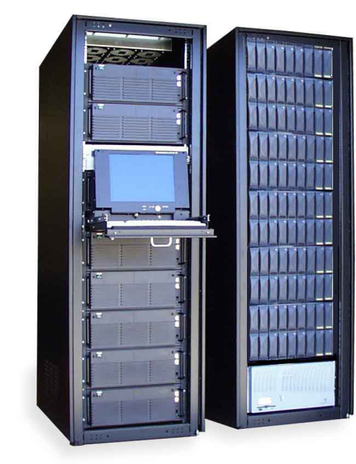
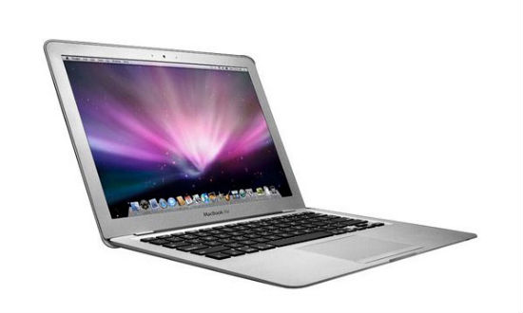

Connecting to a remote computer
Running analysis on a large cluster…
Data
Results
Low computational power
High computational power
Notes:
Imagine you need to perform an analysis that has a huge amount of data and that it would take months to run on your laptop computer. You then discover that your institute has a cluster, which is a group of computers linked together via a local network, comprising this way one only computer with hundreds of processors. You can then ask the administrator to give you an account and all the information for you to access the server from your laptop, upload all your data to it and let it run the analysis. A few days later, the server sends you an information that your analysis is complete, and you can then download from ir the results.

Slide 5

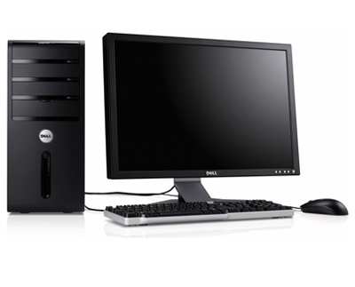

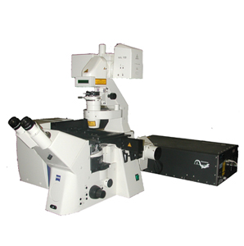


Connecting to a remote computer
Checking in on a lab computer from home…
Internet
Notes:
On a second scenario, imagine you are running a 8h movie with an embryo or a cell culture on a confocal microscope, and this microscope is connected to a desktop on your lab. Its almost 20h, you are hungry, and your mother has made a surprise visit to your home and your wife is alone with her. You know this is sign for catastrophy and staying at the lab during the night is not na option. You then realize that the desktop is connected to a server that has access to the internet and you relieve yourself because now, you can go home, fill your stomach, impede world destruction and log in at any time from your computer to the server and check haw your movie is.

Slide 6
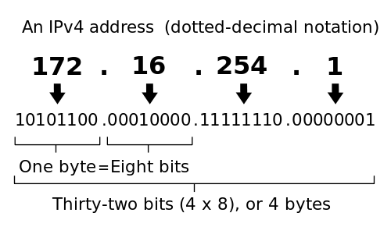
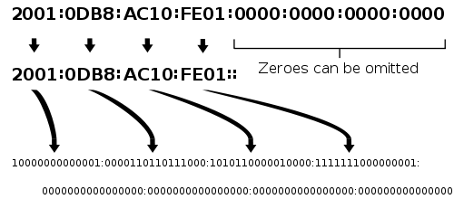
Connecting to a remote computer
Internet Protocol Address - IP
0 - 255
IPv4
2³²
unique addresses
IPv6
2¹²⁸ unique addresses
Notes:
In order to understand how you can connect your laptop (or client) to a server, you need to understand how do they find themselves in the immensity that internet represents.
All computers on the internet are coded with a network number known as the Internet Protocol Address, or IP address.
This address consists of 4, 8 bit numbers ranging from 0 to 255. And you can see them as a succession of specification of the address, as for example the first one specifying your country and the last your computer or network connection. These addresses are generated from a protocol called the IPv4. This protocol is able to give a total of 2 to the 32 unique addresses. However, due to the exponential increase of the internet clients a new protocol was generated and is now running called the IPv6 being able to give 2 to the 128 unique addresses

Slide 7

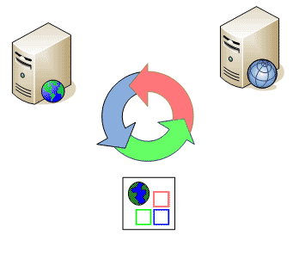
Connecting to a remote computer
DNS server
Web server
77.67.27.49
nature.com
Notes:
Web pages and their specific URL are also assign IP addresses. So when in your browser you want to check the web page of Nature, what the computer does is send a request to the DNS server to identify the IP for the URL you just typed. This IP is then sent to your ISP provider that sends you to the correct address

Slide 8
Connecting to a remote computer
“host” command
myhost:~ lucy$ host www.nature.com
www.nature.com has address 77.67.27.49
myhost:~lucy$ host 134.89.10.74
74.10.89.134.in-addr.arpa domain name pointer pismo.shore.mbari.org.
“whois” command
whois –h whois.arin.net 75.119.192.137
localhost - computer you are logged onto the moment (always 127.0.0.1)
Notes:
You can use the command line “host” to find the IP address for a given hostname. So if you type this, it will give you this.
The inverse can also be applyed.
Sometimes the IP address or name you are trying to find in the host command does not have any availlable information. However, you can use the Whois command to try to get some general information. This is done by typing host and the –h parameter and the name of the host you are trying to find.
This will returen the entire block of addresses from 75.11.192.0 to 75.11.223.255 including the IP you specified

Slide 9
Connecting to a remote computer
Security
Never give your password to anyone (not even system administrators)
Don’t enable any network protocols or services that aren’t essencial
Make sure that all software is up to date
Use encrypted connections (e.g. VPN)
Avoid connecting to servers over open network connections without encryption (e.g. public WiFi)

Slide 10
Secure command-line connections
“ssh” (secured shell) command
Creates an encrypted connection between your client computer and the remote server
Login
Remote computer’s address
Password
Username
ssh username@address
********** (password)
Accept new key – allows the two computers to set up na encrypted communication
Notes:
The network protocol used to login to a remote computer is called ssh for secured shell, and it creates na encypted…
For you to login to a server using the ssh command, you’ll need 3 pieces of informatuion: the remote computer’s address, your username and your password. All these should be given to you by the administrator
So in the terminal, you need to be online to get the connection started. Then you just type… and then insert your password, and you should be loged in the remote computer.
The fist time you connect to a server, it will give you a warning that it has recieved a new key and it will ask you to add it to your keychain.
This key allows the two computers to set up na encrypted communication, so just accept the key!

Slide 11

Secure command-line connections
Remote computers may use a different shell than bash
echo $SHELL
Same command-line tools (mkdir, cd, ls…)
Notes:
Now, one problem you might encounter is that the server that you are loging into could use a different shell than the one you are accostumed to, like bash. So the first thing you can do is check if it does by typing echo $SHELL.
Once you are connected to the server you can use the same command-line tools that you would use on your local compute, like mkdir to create directories, cd to change them and ls to list.

Slide 12
Transfering files between computers
File archiving and compression
Sometimes it’s easyer to compress all files and send them as one…
man zip
…and if zip is not available in the remote conmputer
“tar” command – creating a tarball
myhost:~ lucy$ tar –cf ~/Desktop/scripts_31Mai2012.tar ~/scripts
One or more entries, separated by spaces
Notes:
Imagine that you have a lot of data that has a lot of files you need to analyse. It would be very laborious to upload them all to the server, so one thing you can do is join them all in one file and transfer it as such. You can try to use the man zip command to see some compression options you have.
If zip is not na option on your machine, then you can use the tar command by typing ... This is usefull to create a single file with multiple files in it, but it does not compress them, so the total size will be the sum of all files you archived.

Slide 13
Transfering files between computers
“gzip” command – file compression
myhost:~ lucy$ gzip ~/Desktop/scripts_31Mai2012.tar
Creates a .tar.gz smaller file and deletes the old one
“gunzip” command – file uncompression
myhost:~ lucy$ cd ~/Desktop
myhost:~ lucy$ gunzip scripts_31Mai2012.tar.gz
myhost:~ lucy$ tar –xvf scripts_31Mai2012.tar
Expand indicated file archieve
Notes:
To save time and internet bandwith you can use the gzip command to compress your files.
To uncompress the files, for example in the remote server after being uploaded, you can use the gunzip command.
The xvf parameter in the tar command indicates that you want to expand the indicated file archive

Slide 14
Transfering files between computers
“sftp” (secured file transfer program) command
Transfer files over a ssh connection
Move to the directory in the local machine where you want to send or recieve files
myhost:~ lucy$ sftp lucy@practicalcomputing.org
Connecting to pacticalcomputing.org...
lucy@practicalcomputing.org’s password: ********
sftp> ls
Notes:
To transfer files over na ssh connection you can use the sftp for secured safe transfer program command.
Once a sftp connection is made, the link the two systems is maintained, allowing the transfer of information between the two.
To do this, you must first move the directory in your local machine where you want to send or recieve files.
Then you can connect to your server using its address and your login information, and then typing your password.
If you have authorization to use the remote system, then you are granted the access to the server.

Slide 15
Transfering files between computers
Some common commands when using sftp
Command | Usage
cd | Change directories on the remote machine
get A B | Download file A from remote machine and save as B locally
put B A | Upload file B from the local machine to the remote file A
lcd | Change directories on the local machine
!ls | List of the files on the local machine
!command | Perform the specified shell command on the local machine
exit | Close the sftp connection
Notes:
Some of the commands that can be used in a sftp connection are listed here. Two of the most important are the get and put commands that enable you to transfer files between the systems.

Slide 16
Transfering files between computers
“scp” (secure remote copy) command
Move to the appropriate local directory before runnung the command
For downloading…
scp user@hostname:directory/remotefile localfile
…and uploading
scp localfile.txt user@hostname:remotefile.txt
Notes:
Another way to use the command line without simultaneously navigate through remote and local file systems is by using the scp command.
So to download a file in the server you can write the command like this.
And to upload to it like so…

Slide 17
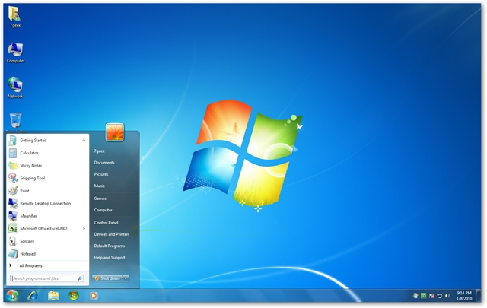
Full GUI control of a remote computer with VNC
VNC – Virtual Network Computing
Access to the complete graphical user interface (GUI) of a remote computer
Notes:
Its is also possible to access to the complete graphical user interface of a remote computer, for exmple your desktop at home, or a server (if it has home).
To do this, you can use the Virtual Network Computing. This has of course its advantages, since you are not required to type everything at the command-line in order to perform the task you want, being sometimes simpler to use some programs that require a graphycal interface to operate.
It has of course the limitation that it requires a lot more internet bandwith than the ssh and in some cases is much less secure.

Slide 18
Full GUI control of a remote computer with VNC
Client
Server
Screen sharing
OS X
Go
OS X
Remote Management
Connect to Server
Windows
RealVNC
Linux
Available in the OS
vnc://serveraddress
Notes:
There must be VNC client and server software running on them respectivelly for this to work.
To mac…

Slide 19


Troubleshooting remote connections
Getting local with a Virtual Private Network (VPN)
Elsewhere
Institute or University Campus
VPN
(encrypted)
Credential verification
Notes:
Some services block computers attempting to connect from the outside. This is usually places where there is sensible information or that a specific login and password are needed to access specific files and information on the server.
For this, if there is one, you can establish a Virtual Private Network or VPN to your university or institute that grants you access to its local network, assigning you a IP address from the local network. This has also the advantage of being encrypted and because of this, much more secure.

Slide 20
Troubleshooting remote connections
Mapping network connections
“traceroute” command
Trace the network steps between your system and na address
traceroute remoteaddress
Notes:
Sometimes you are unable to access to a server or web site. You can trace each step of the connection in order to know where the problem might be.
This is done through the traceroute command.

Slide 21
Troubleshooting remote connections
Configuring the backspace key
Sometimes the backspace key can behave differenly between machines (^H)
“stty” command
stty erase ‘^H’
Notes:
Also, in some servers or machines, the backspace key can behave differently, most of the times giving you a…
To get around this, you can use the stty command to replace the backspace function

Slide 22
Controling how programs run
On regular computers
“sleep” command
Does nothing for a specified number of seconds, and then stops
host:~lucy$ sleep 15
ls
Any command typed while sleep is running will be run after it quits
Notes:
When you are connected to a remote machine, you’ll prabably want to run programs with it in order to analise your data.
This can be done by connecting from home to your lab computer and run it on them. As I told befour you may also want to access a cluster server, but these run on different parameters, so we’ll focus first on regular computers.
For this, we’ll use the sleep command as na example of a process.
The sleep command.

Slide 23
Controling how programs run
Terminating a process
“^C” (ctrl + C) command
Tries to terminate a program that is active in the command line
host:~lucy$ sleep 1000
Typing ^C will end the sleep program and you will get your shell back
Notes:
You can terminate processes using the ctrl+c command

Slide 24
Controling how programs run
Starting jobs in the background
“&” command
Runs the program in the backgroud, enabling the use of the shell
host:~lucy$ sleep 15 &
[1] 4990
host:~lucy$
sleep is running in the background as job number [1] and process ID 4990
Notes:
Ampersand sign to run the program in the background.
To each process, a given ID number is assign

Slide 25
Controling how programs run
Checking job status
“ps” command
Gives a snapshot of current processes
host:~lucy$ sleep 15 &
[2] 4992
host:~lucy$ ps
4800 ttys001 0:00.02 –bash
4992 ttys001 0:00:00 sleep 15
Process identifier (PID)
ps -A
Full list of everything your computer is doing
Notes:
If you want to check the processes curruntly running in your computer, you can use the ps command

Slide 26
Controling how programs run
Checking job status
“top” command
Real-time view of the same list as ps
top –o command
The –o modifier specifies by what parameter you want to sort
Options for the top command
top –o | Sort by the parameter that follows; default is PID
top -u | Sort bu CPU usage; useful for detecting runaway processes
? | While top is running, show a list of display options
q | While top is running, quit
Notes:
If you want a real-time view of the running processes you can otherwise use the top command.

Slide 27
Controling how programs run
Suspending jobs and sending them to the background
“^Z” (ctrl + Z) command
Suspends na operation already running
host:~lucy$ sleep 15
^Z
[1]+ Stopped sleep 15
host:~lucy$ ps
PID TTY TIME CMD
5760 ttys001 0:00.02 –bash
5954 ttys001 0:00:00 sleep 15
Notes:
If you want so suspend a job, if you ran it without running in the background but you need the shell to to other stuff, you can use first the ^Z command. This will freeze the process.
The process will still appear in the ps list because it has not been backgrounded yet

Slide 28
Controling how programs run
Suspending jobs and sending them to the background
“jobs” command
Lists all the background processes
host:~lucy$ sleep 20 &
[2] 5989
host:~lucy$ jobs
[1]+ Stopped sleep 15
[2]- Running sleep 20 &
“bg” command
Resumes a frozen job
host:~lucy$ bg 1
[1]+ sleep 15 &
[2] Done sleep 20
Notes:
You can also list all the background processes running with the command jobs.
You can then know the job number assinged to the process you just stoped and with the bg commang you can restart it again, but this time it will be running in the background.

Slide 29
Controling how programs run
Stopping processes
When a process is running in the background, it will be impervious to interruptions by the ^C command
“kill” command
Terminates any process (even running in the background)
host:~lucy$ sleep 60 &
[1] 5563
host:~lucy$ ps
PID TTY TIME CMD
5089 ttys000 0:00.06 –bash
5563 ttys000 0:00:00 sleep 60
host:~lucy$ kill 5063
host:~lucy$ ps
PID TTY TIME CMD
5089 ttys000 0:00.06 –bash
[1]+ Terminated sleep 60
Notes:
If you want to stop a process in the backgroud there is no way to use the ^C command because the program is not running in the shell at the moment.
To stop a process that is running in the background you can alternitively use the kill command.

Slide 30
Controling how programs run
Stopping processes
When kill doesn’t work…
sudo kill -9 5563
The -9 parameter will force the program to quit
The combined effect with sudo is lethal
Notes:
If this doesn’t work, you can always force the program to quit by entering -9.

Slide 31
Controling how programs run
Keeping jobs alive
When you leave the shell, all processes are terminated with it (even the ones in the background)
“nohup” (no hang-up) command
Indicates that the program should keep running even when the shell is terminated
nohup phrap infile.sff –new_ace > log.txt 2> /dev/null < /dev/null &
Redirects the output file to log.txt
Sends any error messagens to an imaginary place called /dev/nulll
Notes:
If you are acessin on a remote computer and you are making na analysis that takes some time to finish. You might not want to stay connected to the server all the time until its finished. But if you logoff or exit the terminal, then the process will end.
There is a way to keep processes running in the remote machine, while you can go home and rest wile the computer does the job.
This is done by the nohup command.
This should always be indicated befoure the program is ran.

Slide 32
Controling how programs run
Keeping jobs alive
There is also a way to modify a process after it has started so that it doesn’t terminate when the shell closes…
Suspend the process with ^Z command
Send it to the backgroung using bg 1 (or whatever job is reported)
Use the disown command to release it from the shell
disown -h
It can still terminate due to output errors!

Slide 33
Controling how programs run
Changing program priority
“renice” command
Adjusts the priority of each process for processor power
host:~lucy$ ps
PID TTY TIME CMD
29932 ttys000 0:00.01 –bash
29938 ttys000 0:00:06 traxm1HPC –b 13 -#100 ...
host:~lucy$ renice 19 29938
Priority ranging from -20 (highest) to 19 (lowest)

Slide 34
High-performannce computing
Job management tools on clusters
It takes care of issues like priority management and shell termination
Processes will be terminated if they take too long
A configuration file with the analysis needs to be sent to the job manager
Notes:
If you want to access to a cluster to run your data, most likelly it will be run by a job management tool. This ensures that all clients that connect to it have to obey to specific rules of the server, and that not anyone that wants to access to it can, so that everybody can have its share of its wonderful processing capabilities.
So the job managements takes care…

Slide 35
Setting up a server
Install and configure server software for the device you want to provide (ssh, web server…)
Configure the firewall on the server to allow access to the service you will provide
Make sure your local network allows connections to computers from the outside world
Get na IP address or hostname of your server so that other computers can find it
Notes:
(If you want to set up a server in your home or lab desktop computer for example, there are a number of things you’ll need to ensure for this to happen

Slide 36

Setting up a server
Configuring the ssh server
System preferences
Sharing pane
Remole login (check)
Notes:
In the OS X on machintoshes you can set up a sshserver very quickly

Slide 37
Setting up a server
Finding your address
echo $HOSTNAME
host:~lucy$ host $HOSTNAME
Most likelly your IP address will change (hours/days)
Use the system name returned by $HOSTNAME
Request a fixed IP to your network administrator
Notes:
To set a server on linux for example you will need to know your address in order to access to it later on.
You can do this by the echo command and the using the …

