Slide 1
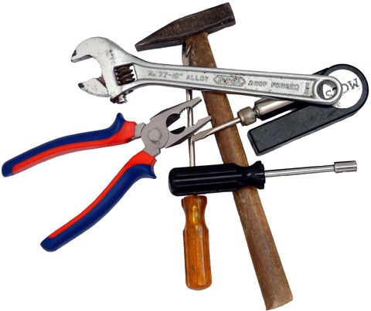
Selecting and Combining Tools
Chapter 14
F. Duveau
02/03/12

Slide 2
Your toolkit
- Regular expressions
To search and replace
- Shell commands
To interact with your computer at the command line
- Shell scripts
To combine / automate command-line operations
- Python programs
For more advanced processing
How to chose the convenient tools for a particular task?
It depends on the kind and number of input data and the amount and frequency of work to perform

Slide 3
Type of input data
- Data from user input
raw-input()
sys.argv[]
- Data from the Internet
curl() or wget() commands, urllib2 module
- Data from other programs
Output of other programs can be captured using redirection (> or >>) or the pipe operator (|)
- Data from hardware
Chapter 22 gives background on ho to interact directly with the physical world
- Data from spreadsheets
Not suitable to manage large and complex datasets

Slide 4
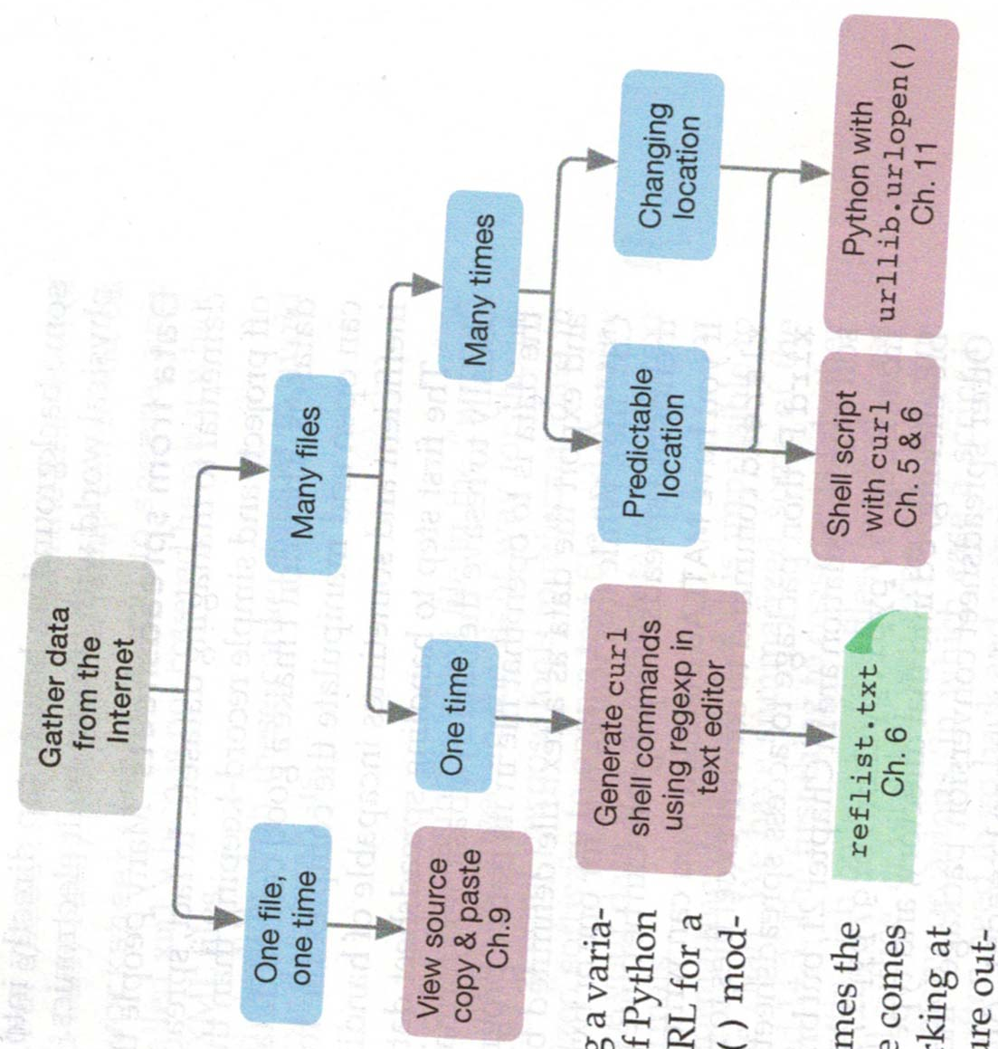
Gathering data from the Internet

Slide 5
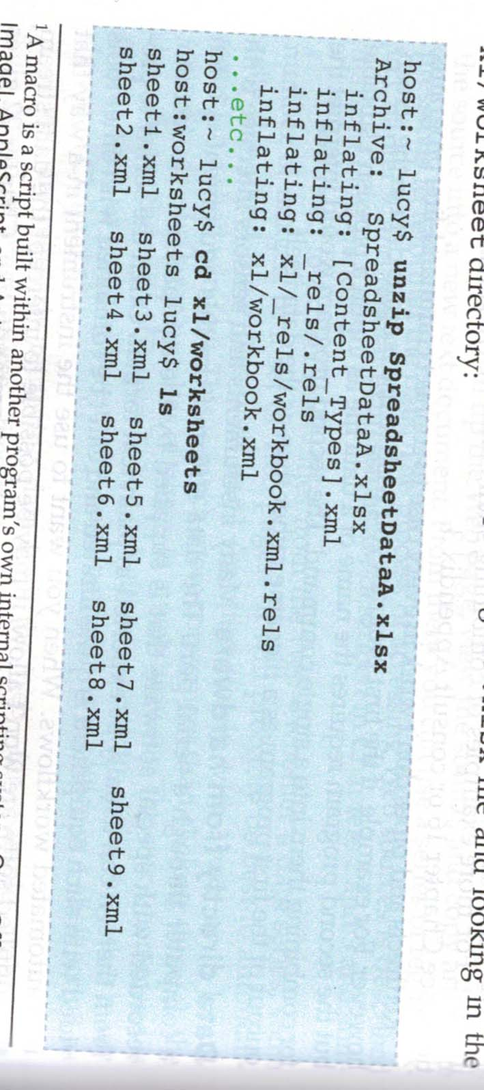
Data from spreadsheets
More suited to small one-off projects and simple record-keeping
The first step is usually to resave the data in a basic text format (eg CSV)
xlrd Python package to access spreadsheet file contents
.xlsx files are compressed archives containing XML files

Slide 6
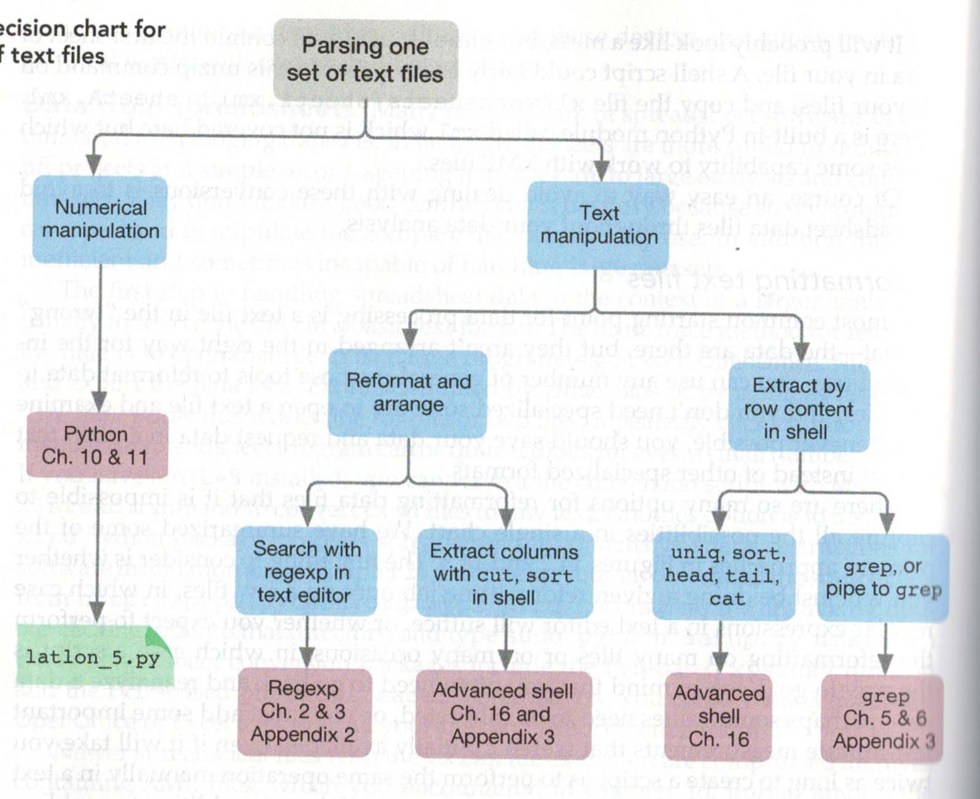
Parsing one set of text files

Slide 7
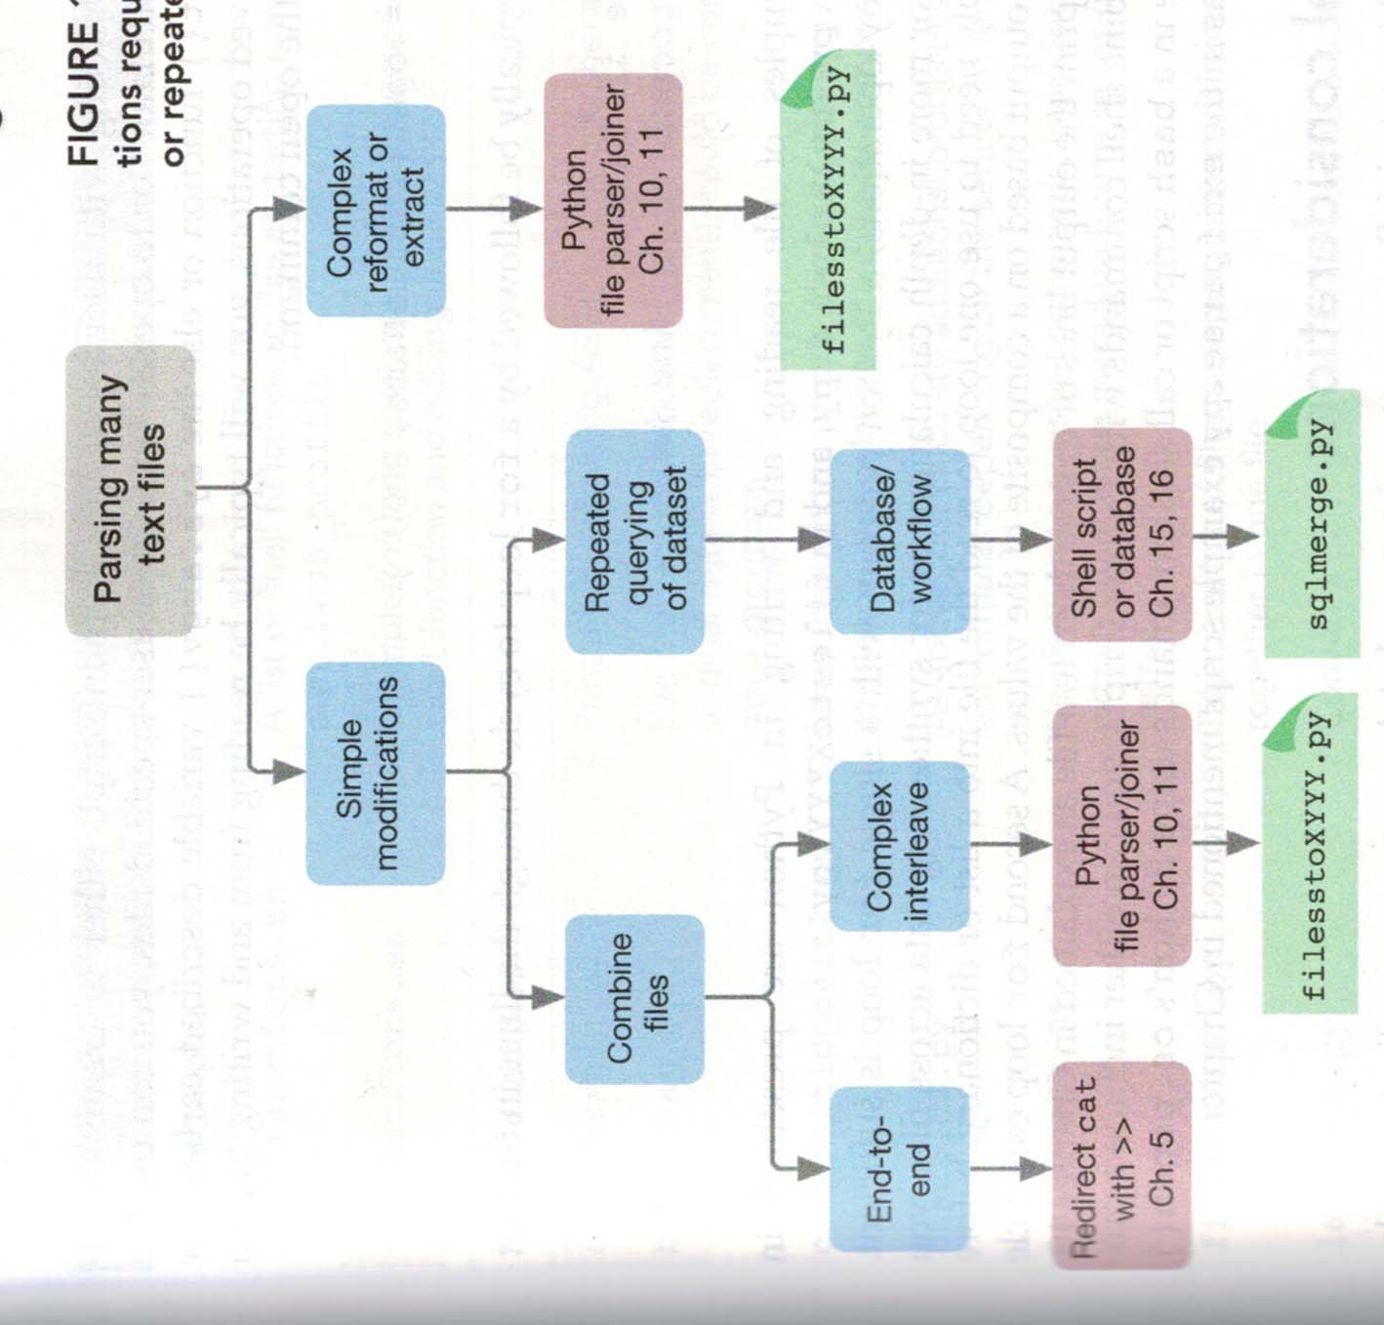
Parsing many text files

Slide 8
Correction of the exercise
- Input data:
html files obtained from the MWG website
- Output:
csv file containing names, sequences and order numbers
STEP 1:
Create a list of primer sequences and names from 1 file
STEP 2:
Extend this list to multiple files (fixed number of files)
STEP 3:
Retrieve the filenames from the order numbers in manage-order.hmtl
Automatically loop over all orders
STEP 4:
Create the list of order numbers
STEP 5:
Write the output file

Slide 9
Collecting data from the Internet
The idea is to adapt the script to find the information directly from webpages instead of manually downloading html files
Problem: The website is secured with HTTPS protocol.
https://ecom.mwgdna.com/services/track/manage-orders.tcl
Strategy to solve this problem (to be implemented in your Python script):
1) Change the default User Agent of Python to simulate a classical web browser
2) Use a Python module (eg. httplib) that can send HTTP orders to the server
3) Send the username and password to the authentication HTTPS address
4) The server should send a response allowing your program to access your primer data

