Slide 1
Guess set of orbitals 𝛟
E
No, E = E’
E’ ≤ E ± ΔE ?
Calculation of J_{ij}, K_{ij}, F, S, C ε and
New set of orbitals 𝛟’
Yes
E’
𝛟’ and E’ are the final orbitals and energy

Slide 2
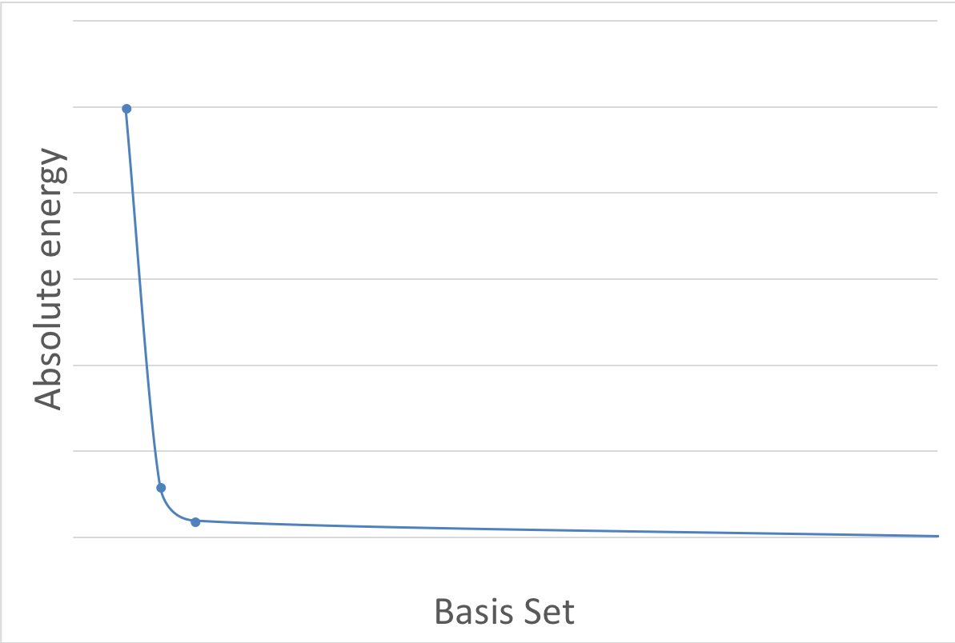
VDZ
VTZ
VQZ
CBS limit

