Slide 1
I.1. Addition nucléophile
Source : Clayden, Greeves, Warren, Organic Chemistry, p 1227

Slide 2
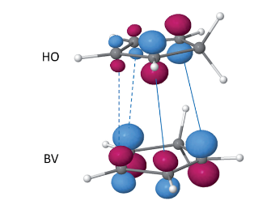
I.3. Cycloaddition
Source : Chaquin, Volatron, Chimie organique une approche orbitalaire, p136

Slide 3
II.2.a. Hydrures chiraux de Noyori
Source : Bruckner, Organic Mechanisms, 3rd edition p 422

Slide 4
II.2.a. Oxazaborolidine de Corey
Source : Bruckner, Organic Mechanisms, 3rd edition p 425

Slide 5
II.2.b. Hydroboration

Slide 6
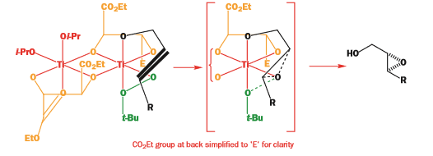
II.2.c Époxydation de Sharpless
Source : Clayden, Greeves, Warren, Organic Chemistry, p 1243

